Slide 1

Primary Care & Public Health Futures
Iowa Public Health Conference
Iowa City
November 17, 2015
Clem Bezold
Institute for Alternative Futures

Slide 2
Introduction
What’s a futurist?
Why Scenarios?
Foresight, including using scenarios is essential for
  Enhancing health, public health and health care

Slide 3
Introduction
Foresight – essential for leaders & organizations
Primary care & public health are both evolving rapidly -Scenarios are an important tool for understanding those directions, and the related opportunities and challenges
Notes:
2
-
Primary Care-Public Health: Inter-professional Leadership Development Institute(Two-day intensive)Track: Leadership
CEUs: 12 CDE, 12 CME, 12 CNE
Times of change require knowledgeable and progressive leaders who are willing to embrace the hard work of not only envisioning the future, but understanding the collaborative nature of fulfilling its promise, especially in dealing with the Social Determinants of Health. This two-day learning laboratory presents a unique opportunity to develop strong collaborative leadership and change management skills for leaders and emerging leaders in the Public Health and Primary Care fields, by tapping into the expertise of both to promote quality community health outcomes.
This experience will focus on successful models of collaboration between Public Health and Primary Care, as well as looking forward at "future scenarios" presented by the Institute for Alternative Futures and the powerful role of leaders in guiding change towards population health. Two practical skills will be addressed: Community Health Needs Assessments and the use of Data & Metrics. In addition, faculty from the Wright Center will present experiential application of the IHI’s High Impact Leadership framework. This session will feature concrete examples of adaptive leadership skills and behaviors to promote creation of "Medical Villages" at the local community level that will actualize the Triple Aim.

Slide 4

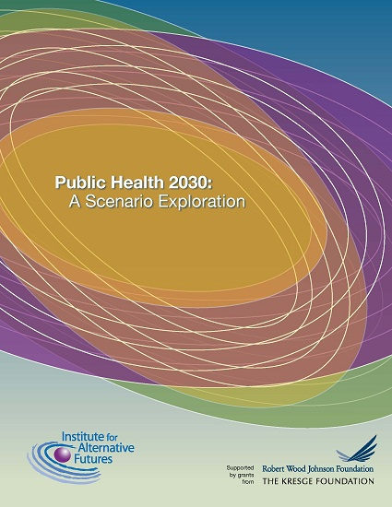
Combining Scenarios

Slide 5
Primary Care 2025 Scenarios
Developed with primary care thought leaders and organizations, NACHC
Considered “Driving Forces”, developed forecasts, interviewed over 50 experts, held focus groups with major providers
Presented and used the scenarios in wide range of settings including primary care associations, physician and provider groups

Slide 6
Public Health 2030 Scenarios
Public Health is “what we as a society collectively do to ensure the conditions for people to be healthy.”
The Who, What, and How of public health is evolving – not always in consistent directions.
Public Health 2030 Scenarios explore the factors shaping public health, and public health’s actions to consider alternative paths into the future.

Slide 7
The Public Health 2030 Project
Funded by Robert Wood Johnson & Kresge Foundations; Following Projects on
Vulnerability 2030,
Primary Care 2025,
Community Health Centers Leveraging the Social Determinants of Health
Health and Health Care in 2032

Slide 8
The Public Health 2030 Project
Objectives of the Public Health 2030 Project
Explore key forces shaping public health
Consider the future of public health functions, financing and sustainability
Build expectable, challenging, and visionary scenarios that facilitate preparation, imagination, aspiration
Provide and widely distribute the scenarios as a tool for public health agencies, organizations, and schools

Slide 9
Developing the Scenarios
Considered key drivers shaping public health
Developed expectable, challenging, and aspirational forecasts for the drivers
Interviewed experts, advisers
Developed and used state and local Public Health 2030 Scenarios
Developed national Public Health 2030 Scenarios

Slide 10
Public Health 2030
Advisory Committee
Georges Benjamin
Jo Ivey Boufford
Renee Canady
Larry Cohen
Joyce Essien
Jonathan Fielding
David Fleming
Denise Holmes
Anthony Iton
Paul Jarris
Jeffrey Levi
Marry Mincer Hansen
Bobby Pestronk
Notes:
Note: PHI staff had input.

Slide 11
State & Local PH2030 Scenarios
Fargo Cass Public Health (ND)
Boston Public Health Commission (MA)
Cuyahoga County Board of Health (OH)
Virginia Department of Health
Notes:
Note to Clem – Background do not go over extensively.

Slide 12
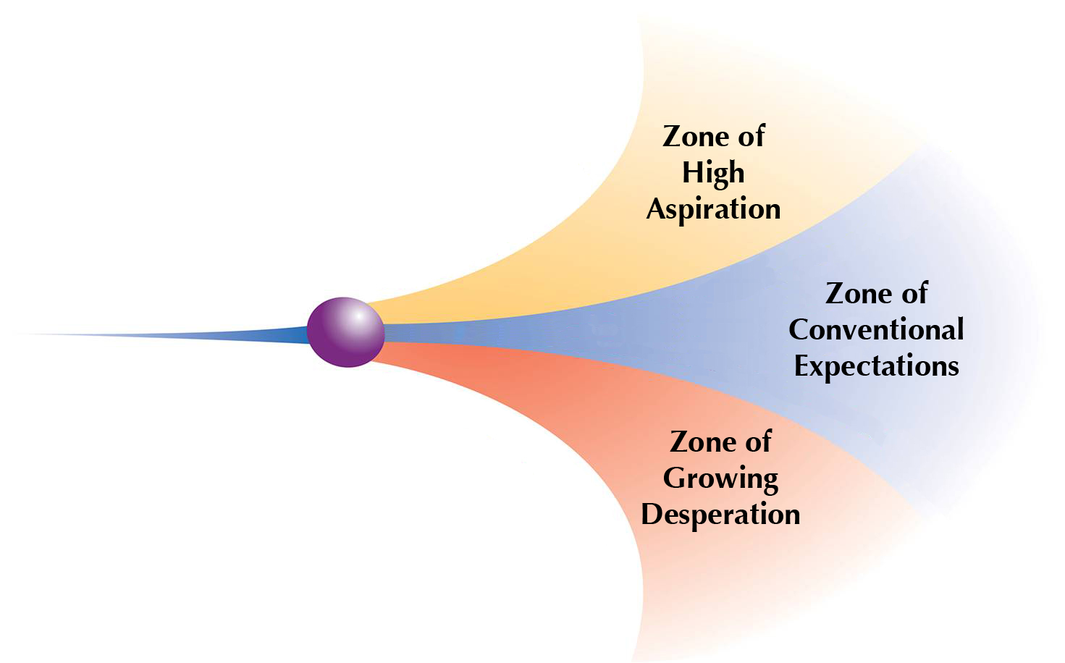
Aspirational Futures: Scenario Zones
Visionary/Surprisingly Successful
Expectable
Challenging

Slide 13
Public Health & Primary Care Scenarios
  Scenario 1: One Step Forward, Half a Step Back for Public Health/Many Needs, Many Models for Primary Care
Scenario 2: Public Health is Overwhelmed, Under-Resourced/ Primary Care sees a Lost Decade, Lost Health
Scenario 3: Public Health leads Sea Change for Health Equity/ Primary Care that Works for All
Scenario 4: Community-Driven Health and Equity for Public Health/ I Am My Own Medical Home for Primary Care

Slide 14
Scenario Likelihood and Preferability Poll
Public Health & Primary Care Scenarios | Likelihood | Preferability
Scenario 1: One Step Forward, Half a Step Back for Public Health/Many Needs, Many Models for Primary Care | 0-100 | 0-100
Scenario 2: Public Health is Overwhelmed, Under-Resourced/ Primary Care sees a Lost Decade, Lost Health | 0-100 | 0-100
Scenario 3: Public Health leads Sea Change for Health Equity/ Primary Care that Works for All | 0-100 | 0-100
Scenario 4: Community-Driven Health and Equity for Public Health/ I Am My Own Medical Home for Primary Care | 0-100 | 0-100
Notes:
Please use the grid below to assess the likelihood and preferability of each scenario separately.
100% refers to highly likely or preferable.
0% means there is nothing desirable or preferable about a particular scenario.
Percentages can be from 0 to 100 in each cell. Columns or rows need not add up to 100%. For example, you may assign 60% for likelihood and 85% for preferability of a scenario.

Slide 15
Disruptive Innovations Shaping Health Care

Slide 16


Primary Care: Disruptive Innovations
Business Model Innovations
Quality - Triple Aim
Integrated payments
The Primary Care Team
Which Home – PCMH to CCHH
Transparency of costs
Retail clinics
Emerging Technologies
Personalized medicine & care
EMR &PHR
Digital coach/navigator
Self Care

Slide 17
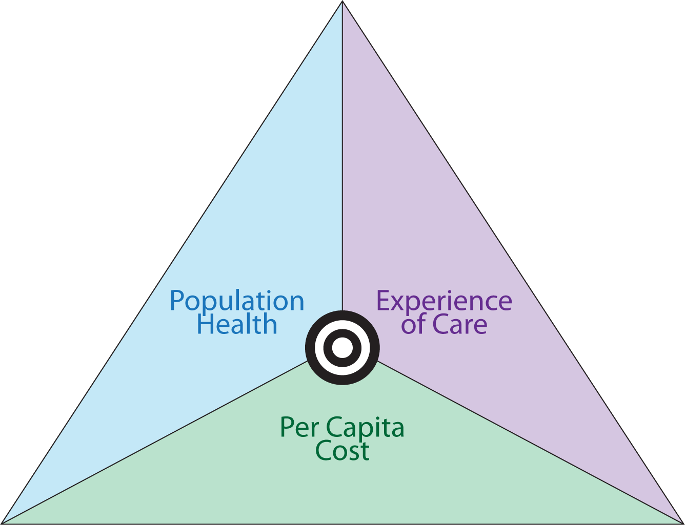
The Triple Aim

Slide 18
Major Factors Shaping Health
 | M1993 | M2002 | HPC | CHR
Behavior | 50% | 40% |  | 30%
Socioeconomic conditions |  |  | 50% | 40%
Environment | 20% |  |  | 10%
Social |  | 15%
Physical |  | 5% | 10%
Genes | 20% | 30% | 15%
Healthcare | 10% | 10% | 25% | 20%
Source: 1993 – M = McGinnis and Foege, JAMA, 1993, 270, 2207-2212; 2002 - McGinnis, Russo, Knickman, 2002, Health Affairs, 21,3,83; HPC – “Healthy, Productive Canada, Final Report of the Senate Subcommittee on Population Health. June 2009; CHR = County Health Rankiings, 2010 www.countyhealthrankings.org/
18
Notes:
Source: M1993 = McGinnis and Foege, JAMA, 1993, 270, 2207-2212; M2002 - McGinnis, Russo, Knickman, 2002, Health Affairs, 21,3,83; HPC – “Healthy, Productive Canada, Final Report of the Senate Subcommittee on Population Health. June 2009; CHR = County Health Rankings, 2010 www.countyhealthrankings.org/ , specifically : http://uwphi.pophealth.wisc.edu/publications/other/differentPerspectivesForAssigningWeightsToDeterminantsOfHealth.pdf

Slide 19
Health Care is discovering what it means to focus on the social determinants of health, something community health centers (CHCs) have done since their origins due to their mandate and structure

Slide 20
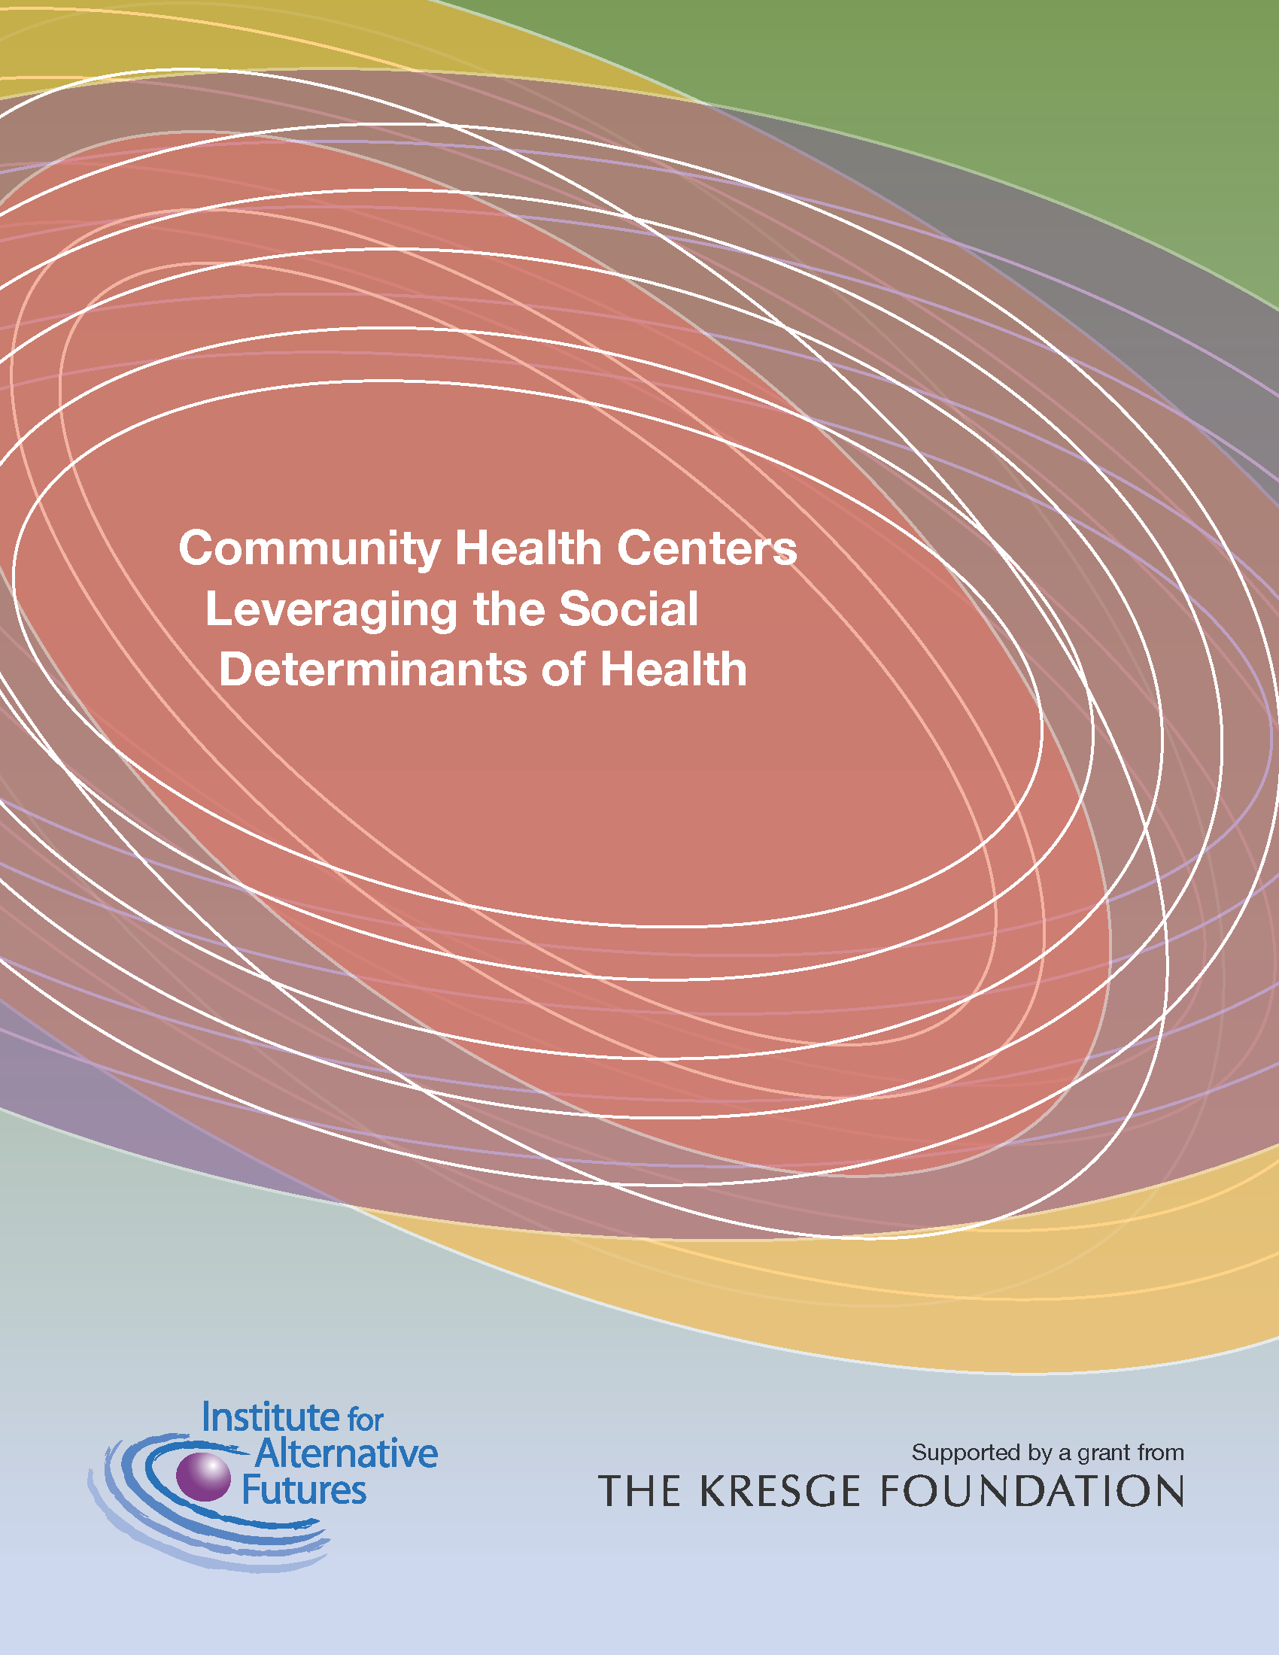
IAF & NACHC, with funding from the Kresge Foundation, created the first data base & analysis of CHCs Leveraging The Social Determinants of Health
www.altfutures.org/leveragingsdh

Slide 21
Most Frequent Types of Efforts in IAF Database
(17 or more out of 176 efforts, among 52 CHCs)
Youth development programs (28% of efforts; 50% of CHCs)
Family and social support (25% of efforts; 31% of CHCs)
Access to healthy foods (23% of efforts; 60% of CHCs)
Job skills, employment, and workforce development (22% of efforts; 40% of CHCs)
Health education (21% of efforts; 50% of CHCs)
Physical Activity and Exercise (19% of efforts; 48% of CHCs)
Community safety, wellbeing, and involvement (19% of efforts; 44% of CHCs)
Nutrition education (16% of efforts; 44% of CHCs)
Healthy, safe, and affordable housing (16% of efforts; 33% of CHCs)
Recreational spaces and improved air and water quality in the community (11% of efforts; 25% of CHCs)
Adult education (10% of efforts; 21% of CHCs)

Slide 22
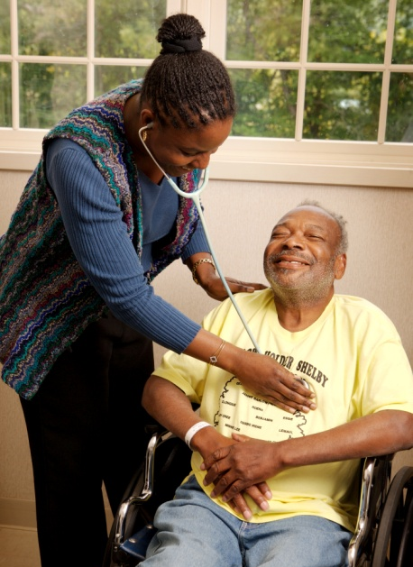

The Primary Care Team
Health care personnel and teams – all practicing at top of licenses
MD/DOs; NPs, PAs; DCs, DPTs; RNs; PharmDs, Behavioral; MAs and CHWs
  Incl. Community Health Workers going into homes with the intelligence and caring of the system

Slide 23

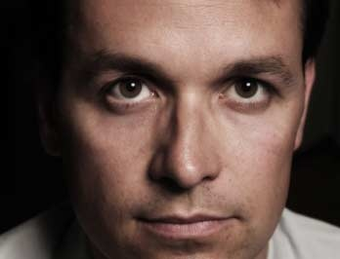
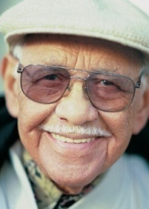




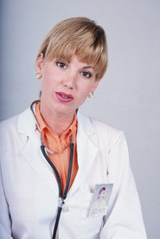




Patient Centered Medical Home
Life-long continuity of care
Coordination of care
Electronic record
Shared decision-making
Education and coaching
Collaborative team of providers

Slide 24
Moving from
Patient Centered Medical Home (PCMH) to
Community Centered Health Home (CCHH)

Slide 25
Community Centered Health Home = PCMH plus:
  Work with community partners to collect data on social, economic, and community conditions
  Aggregate health and safety data; systematically review health and safety trends
  Identify priorities and strategies with community partners and coordinate activity
  Act as community health advocates
  Mobilize patient populations
  Strengthen partnerships with local health care organizations and establish model organizational practices

Slide 26

Health Cost Transparency
Consumers, Payers & Providers will know:
  How much it costs
  How much health care providers get
Comparative Effectiveness of Therapies, Providers & Technologies – PCORI & more
Regions: Grand Junction, CO vs. McAllen, TX; Minnesota vs. Florida or Hawaii vs. New Jersey
Angie’s List, Patients Like Me
Notes:
Image Note: From Twin Cities Business: Toward Free Market Health Care by Andrew Bacski

Slide 27
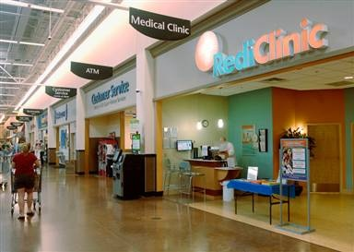
Retail Clinics
Wal-Mart, Rogers, Arkansas
No appointment, out in 15 minutes; Satisfaction rating 4.9 out of 5
Nurse practitioner – 40% savings
Could treat 100 common conditions
Competing against non-consumption
6 million visits 2007-2009 to top 3 chains
Accenture forecasts 2400 to 2800 by 2015, 10.8 mil visits, $800mil.
Notes:
Source for data: Merchant Medicine http://www.merchantmedicine.com/home.cfm
Another accenture forecast has by end of 2015 2868 retail clinics

Slide 28

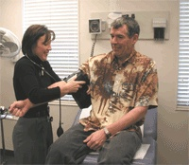
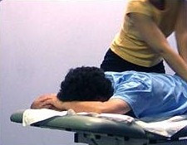
Retail & other clinics
Shopping Malls now have medical spas that do cosmetic procedures
Walgreen’s Health and Wellness division: almost 400 in-store convenient care clinics plus on-site corporate clinics
CVS – about 700 in pharmacies
The Little Clinic - 105
Target – 69 in stores
Notes:
Source: Marty Stempniak, “Retail Clinics: Threat or opportunity?” H&HN News October 1, 2013
http://www.hhnmag.com/display/HHN-news-article.dhtml?dcrPath=/templatedata/HF_Common/NewsArticle/data/HHN/Magazine/2013/Oct/1013HHN_Coverstory

Slide 29
Disruptive Emerging Technologies

Slide 30
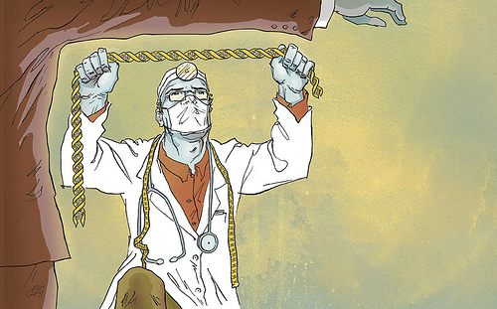

Personalized Medicine and Care
Genomics, Biomonitoring
  Epigenetics, Zipcodeomics; Social Determinant of Health
Personalized definitions of “normal” and disease
Massive data on treatments & side effects analyzed and results used for personalized prescriptions for individuals

Slide 31
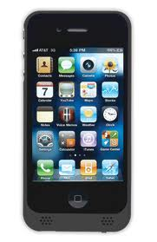
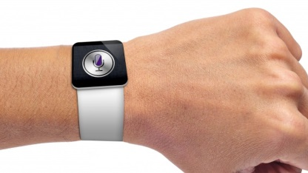
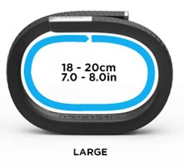
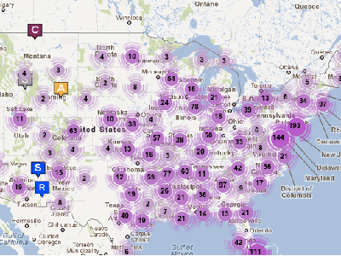
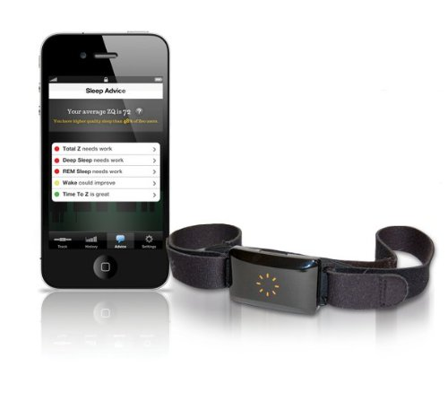
Health Care Knowledge Advances
Personalization
    Biomonitoring
    Genomics, epigenetics, zipcodeomics
    SDH Risks

Slide 32
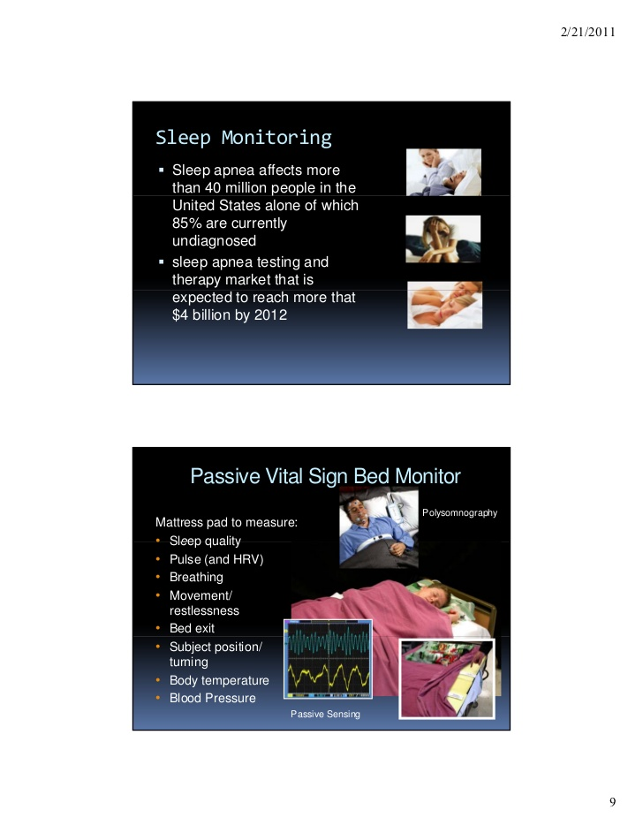
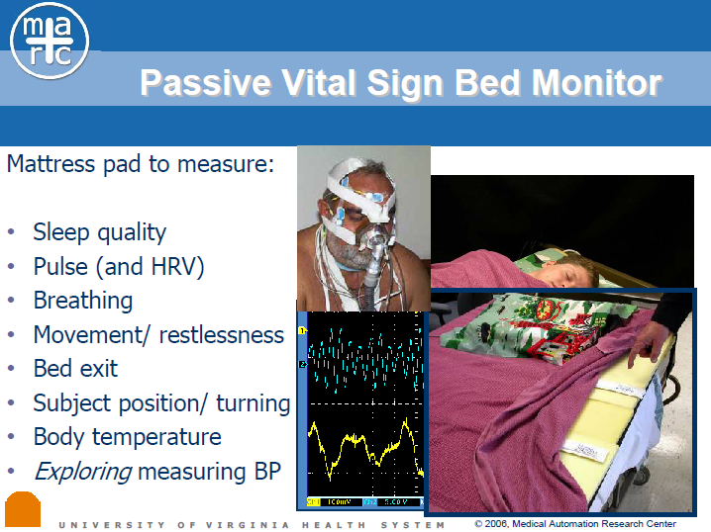
WellAWARE Systems; Medical Automation Research Center
Notes:
CHARLOTTESVILLE, Va.--(BUSINESS WIRE)--WellAWARE Systems, the leading developer of next-generation wellness monitoring solutions for senior care providers, today announced commercial availability of its products. Built by the industry for the industry, WellAWARE is a low-cost monitoring solution that gathers and reports behavioral and wellness information of a cared-for individual, in their home or at a senior living facility. This innovative approach to wellness and safety for senior living enhances the quality of life for our aging population while empowering families and professional care givers with more helpful information.
“As the population of the elderly in the U.S. continues to increase exponentially, we saw an opportunity to help empower families and professional care givers by providing solutions that increase the quality of life for our aging population,” said Jeff Noce, president and CEO of WellAWARE Systems. “By offering a passive, unobtrusive monitoring system, seniors are able to maintain privacy and dignity but allow caregivers to make better-informed decisions about the care they provide their residents based on the wellness and behavioral information collected, processed and analyzed with our technology.”
Our aging population is growing rapidly and remote personal health monitoring is one of the most attractive technology markets. Sales are expected to reach $5 billion in 2010 and explode to $34 billion by 2015 (Forrester 2004). The 65+ segment of the population, “Baby Boomers,” is expected to double over the next 20–25 years and U.S. residents over age 85 have become the nation’s fastest-growing age group, accounting for about 1% of the population.
What started as a concept in 2000 at the Medical Automation Research Center (MARC) at the University of Virginia is now a reality due to investments by two of the country’s largest not-for-profit providers of senior care – Volunteers of America and The Evangelical Lutheran Good Samaritan Society. These groups are also the first two customers to install the WellAWARE technology solution.
“With technology like WellAWARE, we can identify not only emergency situations that need a response, but also emerging medical conditions that our clients might not notice or be able to report on their own,” said Charles W. Gould, national president of Volunteers of America. “I think technology like this will help us make more meaningful and well-informed decisions about potential intervention and treatment of residents and will also allow older people to maintain their independence while still having the peace of mind that someone will be there if they need help.”

Slide 33
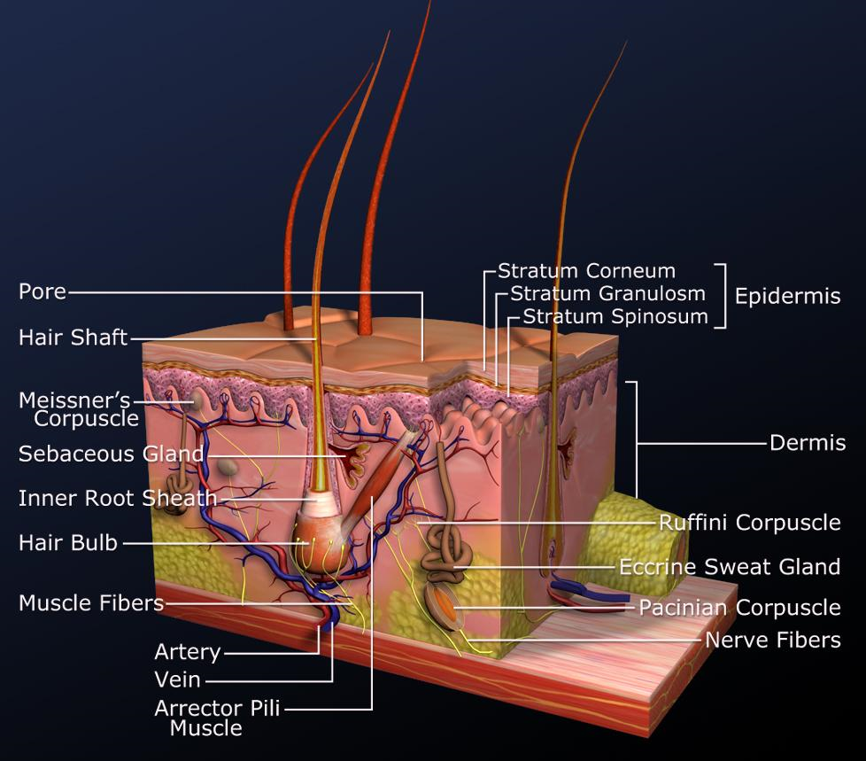
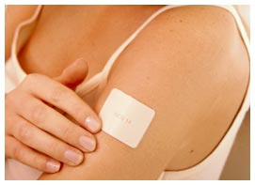
Biomonitoring through the skin
A microsensor painlessly and continuously extracts biological samples
Biological samples that can be analyzed for over 200 biomarkers
A wearable, unobtrusive bandage
Improved comfort = greatly improved compliance
Molecular epidemiology

Slide 34
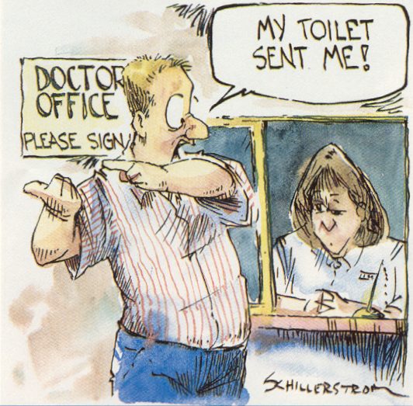
The Home & the Doctor’s Office

Slide 35





Health Care Knowledge Advances
Electronic Medical Records
“Dr. Watson” Expert Support for providers
Digital Health Coach (“avatar”)
Digital health agents, gaming, social networking
Personalized Vital Signs

Slide 36
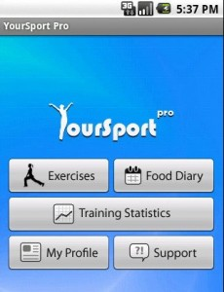
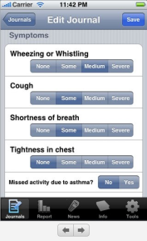
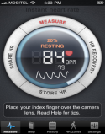

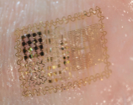
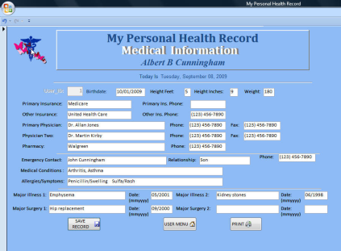
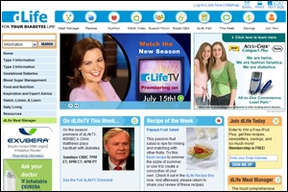
Digital Health Coach Aided By Technologies
Wellness & disease mgmt. apps
Digital coach (“avatar”)
Kaiser, ACOs give these to patients, and big name vendors offer free avatar-based health coaching if other integrated health products and services are purchased
Noninvasive biomonitoring
Personal health record
Facilitated Disease Network
Notes:
Advanced knowledge technologies allow self-care to take over many functions of primary care.
Knowledge systems similar to IBM’s Dr. Watson computer provide access to a wealth of medical knowledge.
Social networks allow friends to exchange information and monitor the health of others.
Avatar-based health coaches provide tailored health advice and behavioral coaching.
Advances in biomonitoring, new vital signs & prospective medicine give consumers greater knowledge of their health.
Consumers buy health-related products and services through competitive markets that offer high transparency of costs and quality.
Demand for human primary care providers declines.
Health care costs are significantly reduced.
The insurance market divides between consumer directed health plans and integrated health systems.
Some fee-for-service options remain, such as “concierge” services for the rich.
Integrated health systems provide primary care to patients who prefer a whole package of care services, including procedures and hospitalizations, from a single entity with competitive annual fees.

Slide 37

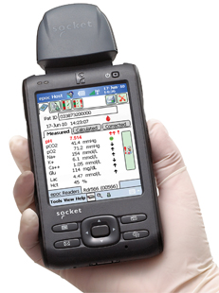


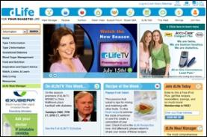

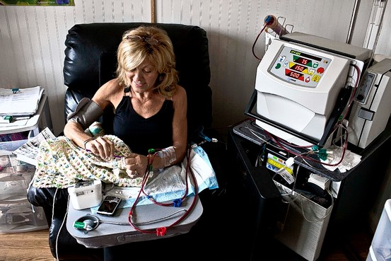
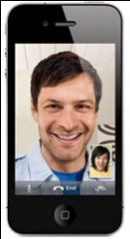


Self-Care
Biomonitoring devices
Facilitated disease network
Digital health coach
Personal health record
Wellness & disease management apps
Telemedicine
Home dialysis
Angie’s List, MINDBODY Exchange for choosing providers
Bring care continuum to patient’s home

Slide 38
  Scenario 1: One Step Forward, Half a Step Back for Public Health/
  Many Needs, Many Models for Primary Care

Slide 39
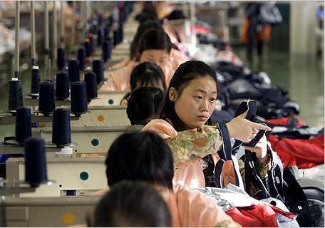
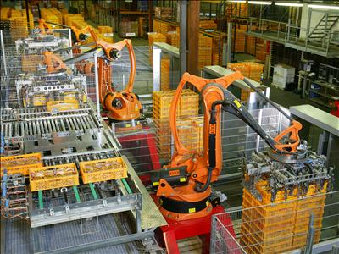
Scenario 1: The Economy
  Sustained but slow economic recovery
  Many jobs automated
  High structural unemployment
  High income inequality
  Nearly 20% elderly, many isolated and poor

Slide 40

Scenario 1: Primary Care
Health care Reform – the ACA
Disruptive innovations
Notes:
Health care evolves
ACA implemented, 90+% are insured
Most providers join ACOs, focus on the Triple Aim
PCMH model widely adopted
Interoperable, secure EHRs include genomic and biomonitoring data
“Doc Watson”/cognitive computing tools, including digital health coaches, help improve care
ACOs conduct CHNAs, most fund/support community groups to improve population health
PHAs step back from personal clinical health services, focus more on prevention and improving community conditions
HC adopts delivery of MCH and HIV/AIDS care
PHAs’ roles with ACOs varies widely
Some PHAs lead in doing analytics, take part in assessments and community priority settings, join community groups and others in addressing priority needs
In some communities ACOs don’t see PHA as having much to offer in analysis or as a cost-effective supplier of programs

Slide 41


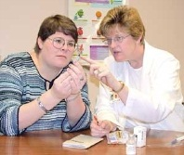



Scenario 1: Primary Care
Expansion of Patient-Centered Medical Home Home
Some shortages of PCPs. All PCMH team members practice at top of license
Prevention
Where Americans receive primary care:
40% Use integrated systems – capitated, continuity
30% Use semi-integrated systems – FFS & P4P
30% Use fee-for-service – lucky poor use CHCs
Notes:
The patient-centered medical home (PCMH) model expands.
Primary care teams broaden and nurse-managed health centers expand.
Employers reduce their health insurance rolls.
Employees use health insurance exchanges to buy insurance.
Primary care improves in aggregate.
Disparities persist among some poor, minority, and rural populations who don’t have access to community health centers.
Sophisticated electronic medical records (EMRs), biomonitoring, new vital signs, digital coaches & personalization are adopted for most primary care practices.
Electronic medical records (EMRs) are ubiquitous, interchangeable, and provide insight into population and genetic analysis.

Slide 42
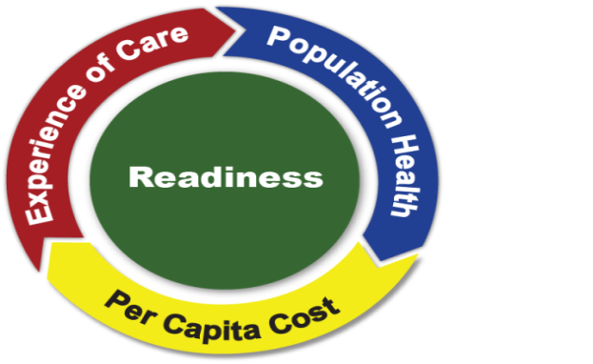
Scenario 1: Health Care
Health care reform largely implemented
Expansion of Accountable Care Organizations (ACOs), Triple Aim, and Patient-Centered Medical Homes (PCMH)
Care improved by knowledge technologies – Doc Watson, digital health coach
PHAs focus on prevention, have varying roles with ACOs
Electronic Health Records (EHRs)
Triple Aim
Notes:
Health care evolves
ACA implemented, 90+% are insured
Most providers join ACOs, focus on the Triple Aim
PCMH model widely adopted
Interoperable, secure EHRs include genomic and biomonitoring data
“Doc Watson”/cognitive computing tools, including digital health coaches, help improve care
ACOs conduct CHNAs, most fund/support community groups to improve population health
PHAs step back from personal clinical health services, focus more on prevention and improving community conditions
HC adopts delivery of MCH and HIV/AIDS care
PHAs’ roles with ACOs varies widely
Some PHAs lead in doing analytics, take part in assessments and community priority settings, join community groups and others in addressing priority needs
In some communities ACOs don’t see PHA as having much to offer in analysis or as a cost-effective supplier of programs

Slide 43
Scenario 1: Primary Care
Electronic Medical Records
“Dr. Watson” Expert Support for providers
Digital health agents, gaming, social networking
Personalized Vital Signs
Notes:
The patient-centered medical home (PCMH) model expands.
Primary care teams broaden and nurse-managed health centers expand.
Employers reduce their health insurance rolls.
Employees use health insurance exchanges to buy insurance.
Primary care improves in aggregate.
Disparities persist among some poor, minority, and rural populations who don’t have access to community health centers.
Sophisticated electronic medical records (EMRs), biomonitoring, new vital signs, digital coaches & personalization are adopted for most primary care practices.
Electronic medical records (EMRs) are ubiquitous, interchangeable, and provide insight into population and genetic analysis

Slide 44

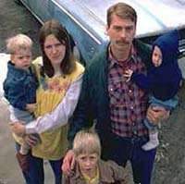
Scenario 1: Health coverage & disparities
Employers drop insurance
Health Insurance Exchanges
→
Significant disparities remain for access and quality
Notes:
The patient-centered medical home (PCMH) model expands.
Primary care teams broaden and nurse-managed health centers expand.
Employers reduce their health insurance rolls.
Employees use health insurance exchanges to buy insurance.
Primary care improves in aggregate.
Disparities persist among some poor, minority, and rural populations who don’t have access to community health centers.
Sophisticated electronic medical records (EMRs), biomonitoring, new vital signs, digital coaches & personalization are adopted for most primary care practices.
Electronic medical records (EMRs) are ubiquitous, interchangeable, and provide insight into population and genetic analysis

Slide 45

Scenario 1: Health Care
Health care costs continue to rise as access improves
Big Data put to use, but social determinants not significantly addressed
No major “game-changers”
Continued disparities
Notes:
Outcomes
Great variations in PHA tech capabilities, funding, and services
HC access, quality, and equity improve, but not paralleled by improvements in SDH
Thus, health care costs continue to rise
No “game-changers” in the field
“Big data” proves useful, but does not transform society in the ways expected in mid-2010s
Some improvements in absolute health measures, but continued disparities across race and class on almost all measures
Combined, public health makes only little gains, still have a long way to go

Slide 46
Scenario 1: Public Health Agencies
Public health agencies (PHAs) advance capabilities in technology and big data analytics
Public health is restrained by
  High costs of health care
  Variations in PHAs’ technological capabilities, funding, services, and effectiveness
  Most PHAs do pursue accreditation
Notes:
PHA funding
Public Health funding varies widely at state and local level
Virtually all states continue to face severe fiscal constraints
Many cities and counties at risk for bankruptcy, some fall over the edge
Federal funding for HC programs reduced as HC access improves
Affects screening and treatment, especially for HIV/AIDS, breast cancer screening, asthma, MCH, immunizations
Local Health Departments (LHDs) consolidate and share more services
Most PHAs improve agency-to-agency comparability, increase evaluation and QI activities, show ROI

Slide 47


Scenario 1: PHA Funding
Public health funding varies widely; Federal funding for health care programs reduced as access to health care improves
  PHAs refocus on prevention and improving community conditions
PHAs consolidate and share services; most improve comparability and show positive returns on investment (ROI)
Notes:
PHA funding
Public Health funding varies widely at state and local level
Virtually all states continue to face severe fiscal constraints
Many cities and counties at risk for bankruptcy, some fall over the edge
Federal funding for HC programs reduced as HC access improves
Affects screening and treatment, especially for HIV/AIDS, breast cancer screening, asthma, MCH, immunizations
Local Health Departments (LHDs) consolidate and share more services
Most PHAs improve agency-to-agency comparability, increase evaluation and QI activities, show ROI

Slide 48
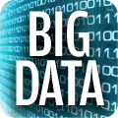

Scenario 1: PHAs and information
Emergence of Big Data
Improved surveillance and analysis
PHAs provide quality control, some “nudge” social networks toward better health
Notes:
Tech advances automate PHA services
“Big Data” emerges, aggregates from EHRs, environmental monitoring, social media data, Medicare and Medicaid reimbursement data, motor vehicle records, employment records, and other government data
Many PHAs leave big data analytics to private sector contractors and local ACOs
Most PHAs use enhanced data to:
Improve surveillance and analysis
Better target community needs
Monitor trends and make better forecasts
Prove positive ROI for the programs they still offer
Monitoring and inspections are automated, PHAs design/approve the systems and provide quality control
Some PHAs seek to “nudge” social networks toward better health
Fewer, but more technically savvy PHA employees needed to manage and respond to monitoring
Scenario 1: PHA Services
When possible, PHAs
Automate inspections
Enhance population health monitoring
Improve emergency preparedness
Some PHAs are confined to mandated services
Others are able to emphasize prevention

Slide 49
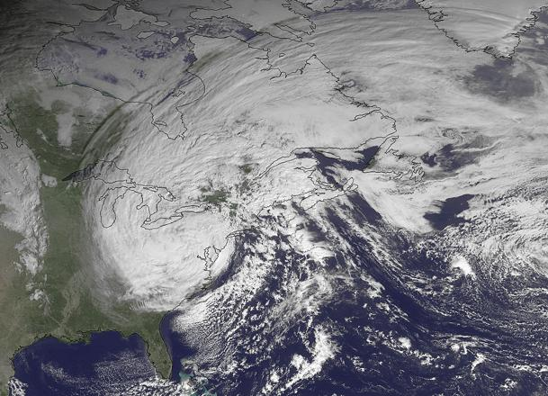
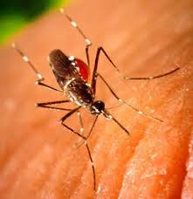
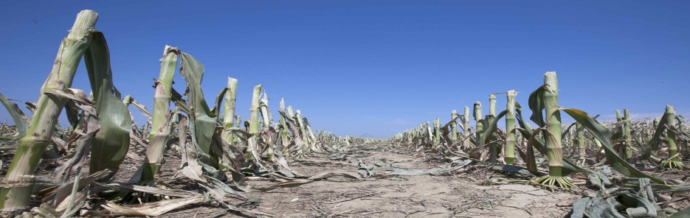

Scenario 1: Climate Change & PHAs
More extreme weather events (EWEs) and vector-borne infections
  E.g. Lyme disease and dengue fever
PHAs use simulations and gamification to prepare communities for emergencies
Notes:
Environmental challenges grow
More and more extreme weather events and vector-borne infectious outbreaks
droughts, floods, tornados, hurricanes, and other storms
Lyme disease and dengue fever, etc.; multiple pandemics
PHAs' use games and simulations to better prepare their communities for emergencies

Slide 51
Scenario 2: Public Health is Overwhelmed, Under-Resourced/ Primary Care sees a Lost Decade, Lost Health

Slide 52

Scenario 2: The Economy
Another severe recession in 2017
  Across-the-board budget cuts
  Reduced spending on social programs
  Unemployment hovers between 10
  and 15%
  Slight recovery by 2019
A third severe recession in 2024
The rich recover fastest after each recession.
Notes:
Scenario 2: Oil Prices
Oil prices soar to > $200/barrel
Food costs rise in tandem
Effect minor for high- and middle-income
Devastating for low-income
Live far from employment
Limited access to public transit
Lower quality cars

Slide 53



Scenario 2:
Political Polarization
Political polarization worsens
  Distinctions based on generation, race, and ethnicity
  Well-to-do fight to keep taxes low
  Baby Boomers remain in workforce and fight
  to keep all benefits
  “Papers, please” laws expand
Notes:
Scenario 2 The Rich have it good
Life is good (if you can afford it)
“Premium lanes” on highways
$160,000/year treatment for Alzheimer’s
Reliable high-speed 6G data plans

Slide 54

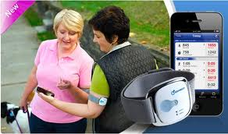
Scenario 2: Health Disparities Grow
Citizen science and technology grow but serve affluent and reinforce disparities.
PHA health care services cut while need grows.
Excellent, personalized care for those who can afford it.
Innovative private sector approaches to health for those who can afford them.
Notes:
Tech and health disparities grow
Citizen science grows but serves affluent
Excellent, personalized care for those who can afford it
Smartphones, wearable devices, and social networking go mainstream, but reinforce economic and educational disparities
Private sector offers innovative approaches to improve health, but unaffordable for vulnerable populations
particularly in advanced analytics, online health education, and preventive self-care

Slide 55
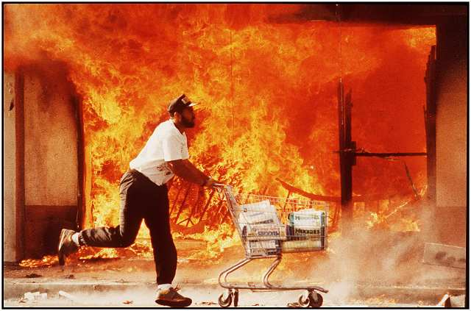
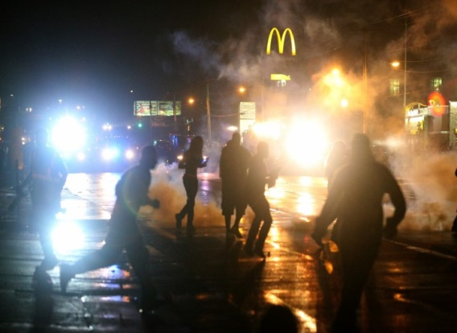
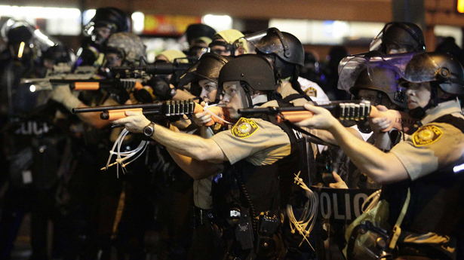
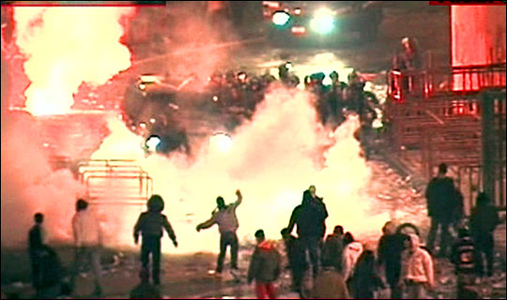
Scenario 2 Inequity &
Social Unrest
Periodic unrest and violence
  Frequent outbreaks of rioting among highly vulnerable populations; Used to justify removing “blight” from urban centers

Slide 56
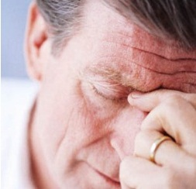
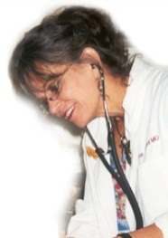
Scenario 2: Primary Care
Health Care Reform reversed
Declining physician revenue
Shortage of primary care providers
Where Americans receive primary care:
30% Use fully integrated systems – capitated, continuity
20% Use semi-integrated systems – mixed FFS- P4P
35% Use fee-for-service – episodic, often poor quality
15% Use concierge fee-for-service – sophisticated tech.
Notes:
Recurring economic challenges prompt significant cuts in Federal health care spending.
Provider shortages intensify
Payment reductions leave many providers ever more dissatisfied.
Many Boomer providers retire early, although many cannot because of losses in retirement savings.
Many insured people cannot find primary care providers
The predominantly fee-for-service primary care market is split between:
“concierge” practices for the rich
“minute clinics” for much of the poor
Integrated and semi-integrated systems become the provider of choice for urban, middle-class consumers.
Community health centers provide high quality care to publicly financed and working poor patients, but some CHCs go out of business.
Health insurance exchanges are underfunded and ineffective, but many employers still stop providing health insurance.
Many uninsured Americans turn to online primary care solutions of variable quality and pedigree (3000 die from one unforeseen side effect alone)
Scenario 2: Primary Care
Those with good insurance access great care with advanced technology
Many more uninsured
Many turn to black market care & unreliable online advice

Slide 57

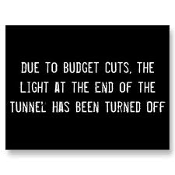
Scenario 2: Public Health Funding
  Given the recessions in 2016 and 2023 PHA funding reduced, many programs eliminated
Notes:
Severe funding cuts and recessions
worsen economic health, many cities follow Detroit into bankruptcy
Need for personal health services through PHAs grows, while funds are cut.
End of Tobacco Settlement Funds in 2025 a death knell for many PHA-led anti-tobacco programs, even while some smoking restrictions and taxes are reduced
PHAs forced to focus on infectious disease, emergency preparedness, and mandated inspections
Under-funded, under-staffed, over-worked
Little prevention, move from crisis to crisis

Slide 58



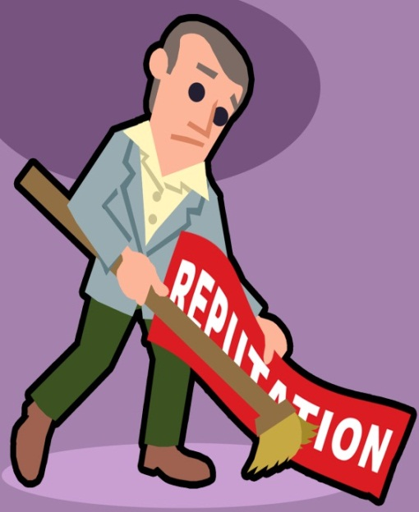
Scenario 2: Public Distrust
PHAs blamed for lack of preparation and ineffective responses
Public distrusts PHAs, federal government in general, and health care
Notes:
Worsening reputation of PHAs
PHAs bear blame in legislative hearings and in the press for lack of preparation and ineffective responses
MPH graduates choose to work in private sector and not in public health
Value of PHAs declined in the eyes of policymakers and the public
Policymakers and the public look to private sector to solve problems
Distrust of PHAs
(refer to recessions as appropriate)

Slide 59



Scenario 2: Epidemic
Flu epidemic in US in 2020
Tens of thousands of people die

Slide 60



Scenario 2: Climate Change Accelerates
“Methane belch” drives “Runaway climate change”
Climate refugees and migrants
Health, violence, and discrimination worsen
PHAs overwhelmed, struggle to recover
Notes:
Runaway climate change in 2025
Infectious disease and climate change
- some followed by increased funding for disaster preparedness and recovery
-
(West Nile Virus, dengue fever, malaria)
Runaway climate change and environmental challenges
Periodically bring PHAs increased funding for disaster preparedness and recovery
Mold and mildew exposure; combined sewer systems and infections and contaminations (killing thousands?? Really??)
New and re-emerging diseases (West Nile Virus, dengue fever, malaria)
Impacts of runaway climate change
Conflicts; climate refugees and migrants; worsening health, violence, and discrimination
PHAs overwhelmed, often didn’t have insurance to recover from damages in their buildings and infrastructure caused by EWEs

Slide 61
Scenario 2: Overwhelmed, Under-Resourced
PHAs understaffed, overwhelmed.
Many universities shut down public health programs.
Private sector innovations ignore disparities and vulnerability.
Worsening disparities in health, quality health care access, effective prevention, and other public health services.
Notes:
Outcomes in 2030
People going into private sector; current employees demoralized
PHAs over-worked, under-staffed, and overwhelmed
Potential PHA staff prefer to go into private sector; current employees demoralized
Many PHAs consolidate, some turned into non-profits, some are eliminated or subsumed into other government agencies.
Many PHAs consolidated, privatized, turned into non-profits, eliminated, or subsumed into other government agencies. The survivors are afraid in taking any chances that might subject them to further public scrutiny.
Many universities shut down their public health programs
Health aspirations of public are not pursued through public health establishment but thru private sector innovations that do not address the needs of society’s most vulnerable members
Many, especially in low income populations, lack access to quality health care, effective prevention, and other public health services
More illness, violence and crime, health disparities became starker

Slide 62


Slide 63
Scenario 3: Public Health leads Sea Change for Health Equity/ Primary Care that Works for All

Slide 64
Scenario 3: Sea Change for Health Equity
Changes in values and demographics.
Funding improves for public health.
Public health pursues advanced analytics, gamification, and multisectoral partnerships.
Improvements in housing, economic opportunity, education, and other social determinants of health.
Some disparities persist.
But in 2030, the vast majority of Americans have attained greater opportunity for good health.

Slide 65



Scenario 3: Policy & Political Shifts
Support for “common sense” policy
Public support for opportunity, equity, and fairness in policies and economics
  National minimum wage, Health in All Policies
Innovation and use of new tech for outcomes
Demographics shapes politics; Texas turns blue
Notes:
Values and demographics change to support "common sense" policies and health equity
Working population changes rapidly, younger cohorts bring:
Innovation and new tech to improve outcomes
Clear and surprisingly rapid growth to government and private sector support for opportunity, equity, and fairness in policies and economics
National minimum wage fixed at inflation adjusted living wage level

Slide 66



Scenario 3: Equitable Economy
Value shift toward fairness and sustainability
  Minimum conditions need to be met for all
  Gross inequalities in income and
  wealth no longer acceptable

Slide 67



Scenario 3: Policy Changes
New policies at federal and state levels
  Large fiscal investments in energy, transit, and IT; Accelerated Smart Grid t; and Clean Energy R&D initiative
  Government agencies take holistic
  client-centered approach
  Expanded social supports
  Health in All Policies becomes the norm
  Medicaid incorporates “best practices”
  of private and non-profit health care providers
  Stronger work requirements for receiving benefits

Slide 68


Scenario 3: Primary Care That Works for All
Expanded team of providers
Community Centered Health Home
Triple Aim
Where Americans receive primary care:
(Near universal health insurance coverage)
85% Use integrated systems – capitated, continuity
10% Use concierge fee-for-service
5% Uninsured use Community Health Centers & ERs
Notes:
Policy-makers actively pursue the “triple aim” of improved patient experience, reduced cost, and improved population health.
Primary care team expands to include social workers and community health workers
Near universal access to health care is achieved through integrated systems with risk-adjusted global health care payments.
The PCMH evolves into Community Centered Health Home that focuses on the individual and the community.
Leaders at all levels effectively leverage the social determinants of health at the community and neighborhood levels.
Advanced knowledge technologies and community mapping allow for identification and remediation of “hotspots” of ill health.
Payment systems use sophisticated statistical methods and apply the decision principle:
If it’s smart, we’ll pay for it.
Most payments are capitated with rewards for improved health outcomes.

Slide 69

Scenario 3: Primary Care That Works for All
Proactive electronic records, virtual access, coaching.
Advanced knowledge technologies and community mapping allow for identification and remediation of “hotspots” of ill health.
Photo Credit: Arizona Department of Health Services (ADHS) Cancer by Community Health Analysis Area (CHAA). Accessed January 4, 2012. <http://www.azdhs.gov/phs/azchaa/>.
Notes:
Policy-makers actively pursue the “triple aim” of improved patient experience, reduced cost, and improved population health.
Primary care team expands to include social workers and community health workers
Near universal access to health care is achieved through integrated systems with risk-adjusted global health care payments.
The PCMH evolves into Community Centered Health Home that focuses on the individual and the community.
Leaders at all levels effectively leverage the social determinants of health at the community and neighborhood levels.
Advanced knowledge technologies and community mapping allow for identification and remediation of “hotspots” of ill health.
Payment systems use sophisticated statistical methods and apply the decision principle:
If it’s smart, we’ll pay for it.
Most payments are capitated with rewards for improved health outcomes.

Slide 70


Scenario 3: Health Care & Public Health
Health care improves
Capitated, effective, accessed
ACO’s & Primary Care support community prevention
Cuts in Federal $ to PH programs for screening and treatment
PHA’s guide health care providers and the community in prevention
Community Centered Health
Home
Notes:
Nearly all gain access to capitated and effective care
Primary care evolves to CCHH model

Slide 71

Scenario 3: Public Health Funding
Public health funding improves
Economies gradually grow, reduce fiscal strains and cuts
PHAs foster additional resources from business, foundations, ACOs
Evaluations show positive ROI
Congress restores Prevention Fund restored to $2B level in 2020, add 2% tax in 2022 on medical services
Notes:
National and local economies gradually grow
Eval of policies, programs, expenditures becomes routine
Use advanced analytics to assess and compare
Regularly demonstrate ROI and effectiveness, buffer from spending cuts
In 2020, Congress restores the Prevention and Public Health Fund to $2B level

Slide 72


PHAs become health development agencies, chief health strategists, shift away from direct services
Scenario 3: “Health Development Agencies”
Collaborative networks and partnerships
Simulations, forecasts, analyses
Spread best practices
Identify most cost-effective and appropriate providers
Notes:
Growing collaborative network of PHAs (“public health enterprise”)
Compare/learn from peers in other jurisdictions
Provide comparative cost analysis
Better able to secure state and local funding
Partner with ACOs, universities, and citizen scientists
to improve epi, community interventions, and guidance of behavior change
Improve planning with real-time virtual simulations of community health
Based on data from medical, social, environmental, and socioeconomic sources
Forecast trends, quantify costs of potential events (e.g., flu pandemic)
Lead in analysis and dissemination of best practices for community interventions
Identify most cost-effective and appropriate provider of a program or service
Scenario 3: Public Health Tools & Leadership
Gaming changes communities’ awareness of and commitment to achieving health
New tech developments are made to be affordable and culturally appropriate
PHAs lead coalitions, recognized by the public as chief health strategists
PHAs recognized by the public as chief health strategists
Games developed and used by PHAs include PRIVILEGED -

Slide 73


Slide 74
Scenario 4: Community-Driven Health and Equity for Public Health/
I Am My Own Medical Home for Primary Care

Slide 75
Scenario 4: Community-Driven Health
and Equity
Health improvement initiatives coalesce via technology and networks into a broad, national public health infrastructure.
Value shift to equity was accelerated by another major recession and economic transformation.
The nation tries to come to terms with its racial and socioeconomic histories, and tries to create a more equitable society.
Public health sheds many functions and facilitates these movements to improve health.

Slide 76




Scenario 4: Recession
Major recession in 2017
  High unemployment
  Budgets cut

Slide 77


Scenario 4: Inequality
While all groups were affected, minorities were particularly hard-hit
Notes:
http://www.mediabistro.com/fishbowlla/politico-is-hiring_b7138 for blacks in line above This is the american way

Slide 78


Scenario 4: Demand for Fairness
Revolt against the unfair economy by the poor and declining middle class –
  It was wrong in the 1930’s and in the 2010’s
Active majority demand economic growth, fairness
Notes:
http://www.dnainfo.com/20100908/chelsea-hells-kitchen/demand-has-spiked-for-meals-at-chelsea-soup-kitchen/slideshow/popup/35098 - for colored photo of soup line with episcopal church sign

Slide 79





Scenario 4: Alternative Economics
With governments constrained by debt, and growing loss of jobs communities find solutions close to home
  Barter and “collaborative consumption”
  Time-banks for exchanging time
  Car-sharing, bike-sharing, social lending, etc.
  New arrangements to get the things you need

Slide 80




Scenario 4: PHAs and alternative economics
Governments spend less and spend “smarter”, including on PHAs
PHAs aid the shift to alternative economics/new community economic models
Notes:
New community economic models
Declining government revenues required budget cuts and “smarter” spending, along with job loss accelerated shift to alternative economics
Engage community members in food production, collaborative consumption other sharing, as well as taking part in building community resilience, and enhanced environmental health and emergency response
Time Banks ultimately became community networks that enhance community coherence, they merge the interests of the wealthiest and poorest residents
E.g., Tri-State Time Bank was noted for its work after Superstorm Richard

Slide 81


Scenario 4: Local Communities
Revival of local institutions
  Communities pursue new vision of local development
    Equity promotes health
    Local credit unions, community banks, and local money proliferate
    Urban design of walkable, mixed-use, mixed-income neighborhoods
  Community-level social movements
    Environmental “citizen science”
    Movement against housing segregation

Slide 82

Scenario 4: Primary Care
Advanced knowledge technologies allow self-care
Wellness & disease mgmt. apps
Personal health record
Facilitated Disease Network
Digital coach (“avatar”)
Big name vendors offer free avatar-based health coaching if other integrated health products and services are purchased
Noninvasive biomonitoring
40% Consumer Directed Health Plans – self-managed care
40% in integrated Care systems
10% Concierge Care
10% Uninsured – use ER and CHCs
Where Americans receive primary care:
Notes:
Advanced knowledge technologies allow self-care to take over many functions of primary care.
Knowledge systems similar to IBM’s Dr. Watson computer provide access to a wealth of medical knowledge.
Social networks allow friends to exchange information and monitor the health of others.
Avatar-based health coaches provide tailored health advice and behavioral coaching.
Advances in biomonitoring, new vital signs & prospective medicine give consumers greater knowledge of their health.
Consumers buy health-related products and services through competitive markets that offer high transparency of costs and quality.
Demand for human primary care providers declines.
Health care costs are significantly reduced.
The insurance market divides between consumer directed health plans and integrated health systems.
Some fee-for-service options remain, such as “concierge” services for the rich.
Integrated health systems provide primary care to patients who prefer a whole package of care services, including procedures and hospitalizations, from a single entity with competitive annual fees.

Slide 83
Scenario 4: “I Am My Own Medical Home”
40% of the population opts for self-care and high deductible insurance.
Consumers buy health-related products and services through competitive markets that offer high transparency of costs and quality.
Demand for human primary care providers declines.
Health care costs are significantly reduced.

Slide 84

Scenario 4: Public Health Leads
PHAs facilitate advances in
  Technology
  Alternative economics
  Community engagement
  Reconciliation
  Health in All Policies
  Emissions reduction
Notes:
National Infrastructure and Groupnets
Groupnets are circles of up to 10 people who interacted with each other in real time and with great intensity
Online engagement increases and improves behavioral health at the micro-level, often through peer uplift
Community organization around health is enhanced, and accelerates successful activities
People look to PHAs as authorities on distinguishing good information from bad, and knowledge from opinion

Slide 85

Scenario 4: Public Health Nudging Technology
Groupnets used to improve behavioral health at the micro-level, often through “peer uplift”
Community activity & organizations focused on health
PHAs lead on information quality & community facilitation
Notes:
National Infrastructure and Groupnets
Groupnets are circles of up to 10 people who interacted with each other in real time and with great intensity
Online engagement increases and improves behavioral health at the micro-level, often through peer uplift
Community organization around health is enhanced, and accelerates successful activities
People look to PHAs as authorities on distinguishing good information from bad, and knowledge from opinion

Slide 86



Scenario 4: PHAs Facilitating & Using Games
Health records integrated with other personal and community data to allow advanced health analysis and targeting
Community health learning systems enhance PHAs’ roles as facilitators and health strategists
Games and simulations improve community engagement and planning
Notes:
Big data and community engagement
Health records aggregated with other personal and community data to allow advanced health analysis and targeting
PHAs use this data to research and target prevention strategies
Health Care Providers community benefits funding priorities
Community health learning systems increases collaboration and effectiveness, greatly enhances PHAs’ roles as facilitators and health strategists
Games and virtual simulations improve community engagement, planning, and emergency preparedness and response
Inspections automated and other information added; PHAs become authorities on distinguishing good information from bad
Local economic activity supported by technological breakthroughs
Inexpensive and efficient solar cells using
High-capacity batteries
Local & 3D manufacturing
High-yield aeroponic home food
production
Innovations in urban sustainable
agriculture

Slide 87



Scenario 4: Environmental Health Advances
Environmental Health evolves
Public health works with communities, and partners to reduce environmental impact and expand renewable energy.
Highly effective pre-event resilience games and simulations for Extreme Weather Events.
Notes:
Environmental Responsibility and Sustainability
Extreme weather events become more frequent and more powerful as a result of climate change
Pre-event resilience games and simulations proved important in 2024 in the highly effective and coordinated preparation for and response to Superstorm Richard, which hit Delaware, NJ, and NY.
Mind-change in the public - recognition of climate change and a national commitment to mitigation
Public support for emergency preparedness, community goal setting, and Health in All Policies
PHAs work with community residents, private partners, and NGOs to reduce environmental impact and expand renewable energy
Establish “no emissions” and “reduced emissions” zones
Prepare neighborhoods for creating and implementing community health preparedness and resilience plans in light of EWEs

Slide 88


Scenario 4: Fairness, Justice & Reconciliation
Economic and social justice movement progressed
“Truth and Reconciliation” processes spread
New legislation promotes social and economic fairness
Notes:
Truth and reconciliation
Economic and social justice movement progresses, communities begin to accept the fact that they needed to openly address racial and discriminatory injustices
Many communities had “Truth and Reconciliation” processes, awareness of economic injustice grew; leading to new legislation to promote social and economic fairness:
National living wage, tax fairness, expanded Earned Income Tax Credit that effectively creates the negative income tax first proposed by the Nixon administration in the 1970s

Slide 89


Scenario 4: Community-Driven Health and Equity
Public health graduates are trained for community engagement and advanced analytics
PHAs serve as effective chief health strategists
Disparities are reduced and the nation is largely unified in seeking to eliminate them
Notes:
Outcomes in 2030
Public health graduates are trained for community engagement and advanced analytics
PHAs serve as effective chief health strategists
Disparities are reduced but persist, and the nation is largely unified in seeking to eliminate them

Slide 90


Slide 91
See the Public Health 2030 Scenario Matrix for a side-by-side comparison of the scenarios across multiple dimensions
 | Scenario 1 | Scenario 2 | Scenario 3 | Scenario 4
MACRO AND OPERATING ENVIRONMENTS
Economy
Fiscal Health
Internet & Social Media
Environmental Threats & Impacts
Health Care
Health Equity
Public Health
Public Health Roles
Funding for Public Health
Public Health & Health Care
Health Care’s Role in Population Health
Surveillance and Epidemiology
Emergency Preparedness
Environmental Health/Safety
Injury and Violence Prevention
Etc.

Slide 92
Scenario Likelihood and Preferability Poll
Public Health & Primary Care Scenarios | Likelihood | Preferability
Scenario 1: One Step Forward, Half a Step Back for Public Health/Many Needs, Many Models for Primary Care | 0-100 | 0-100
Scenario 2: Public Health is Overwhelmed, Under-Resourced/ Primary Care sees a Lost Decade, Lost Health | 0-100 | 0-100
Scenario 3: Public Health leads Sea Change for Health Equity/ Primary Care that Works for All | 0-100 | 0-100
Scenario 4: Community-Driven Health and Equity for Public Health/ I Am My Own Medical Home for Primary Care | 0-100 | 0-100
Notes:
Please use the grid below to assess the likelihood and preferability of each scenario separately.
100% refers to highly likely or preferable.
0% means there is nothing desirable or preferable about a particular scenario.
Percentages can be from 0 to 100 in each cell. Columns or rows need not add up to 100%. For example, you may assign 60% for likelihood and 85% for preferability of a scenario.

Slide 93
Visualizing Your Scenario
Notes:
Fall in Iowa 2028 -- Your assigned scenario has occurred
Imagine – colors, air, … sounds
Visit
LHD – how has the work changed?
Surveillance, inspections
Preparedness, post event resilience – climate challges over last 15 years in the state
Health department staff - job losses, function changes
Budgets, support
A primary care clinic/setting/CHC
Patients in the waiting room?
Interview PCP –
% who televisit or who use the providers AI/expert systems
What’s in the record
Genomics
SDH – zipcode omics
Primary Care’s role in increasing population helath – what does that mean in terms of focus, programs; how does the PCP work with public health

Slide 94
Exploring one Scenario: Small Group Discussions
You have been assigned one of these four scenarios. The objective is to explore that scenario, consider the implications, and answer these questions:
What were the most striking changes you saw in your visualization of your scenario in 2030?
Assume that the scenario you are in happens. What are the implications for your organization? (e.g. its vision, work, strategies, personnel)?
Given the assumptions in your scenario for health care and public health (see bottom of page 33 and top of page 34 of the matrix) – how will your public health and health care organizations work together?

Slide 95

Public Health 2030 www.altfutures.org/publichealth2030
Primary Care 2025 www.altfutures.org/primarycare2025
Vulnerability2030 www.altfutures.org/vulnerability2030
Supported by grants from:

